Slide 1

Hyperbolic functions
STRILETCHI VLAD

Slide 2
In mathematics, hyperbolic functions are analogues of the ordinary trigonometric functions, but defined using the hyperbola rather than the circle. Just as the points (cos t, sin t) form a circle with a unit radius, the points (cosh t, sinh t) form the right half of the unit hyperbola.
sinh z = 1/2(e^z − e^(−z)) cosh z = 1/2(e^z + e^(−z))

Slide 3
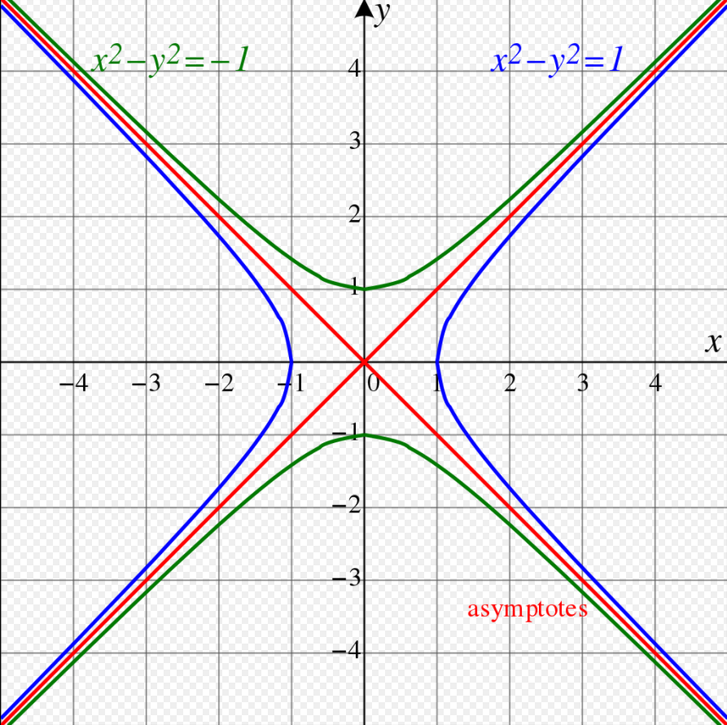
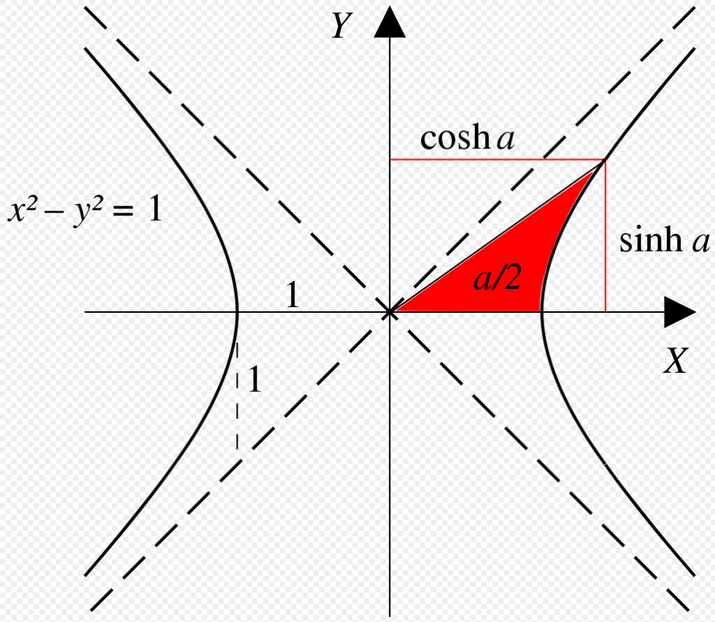
The unit hyperbola.(blue)
The unit hyperbola

Slide 4
The hyperbolic cosine function may be used to describe the shape of the curve formed by a high-voltage line suspended between two towers (see catenary). Hyperbolic functions may also be used to define a measure of distance in certain kinds of non-Euclidean geometry.
Their use

Slide 5
Hyperbolic functions are used to design arches that will provide stability to structures.
Their use

Slide 6
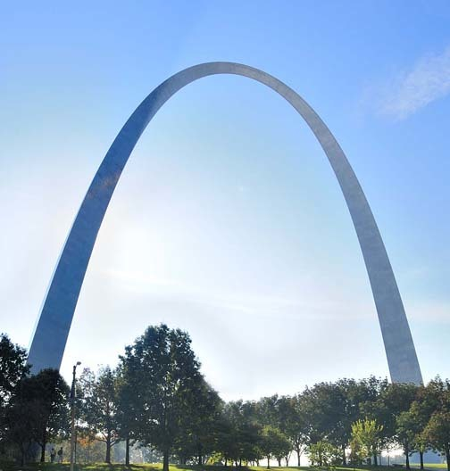
The St. Louis Gateway Arch — the shape of an upside-down hyperbolic cosine.
Their use

Slide 7
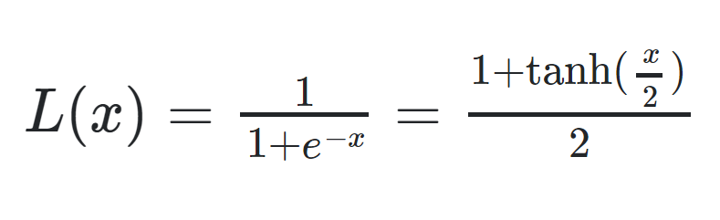
In Computer Science, hyperbolic functions are often used as part of the activation functions for neural networks. (Ex.: Logistic function)
Their use

